Slide 1
Efficient Estimation of Word Representations in Vector Space
Tomas Mikolov
Greg Corrado
Kai Chen
Jeffrey Dean
Presented by:
Sadman Shafi

Slide 2
Introduction
Words need appropriate numerical representations/embeddings for natural language processing tasks
Authors introduce two methods to create word representations
The two methods have less computational complexity
Accuracy and training speed are tested

Slide 3
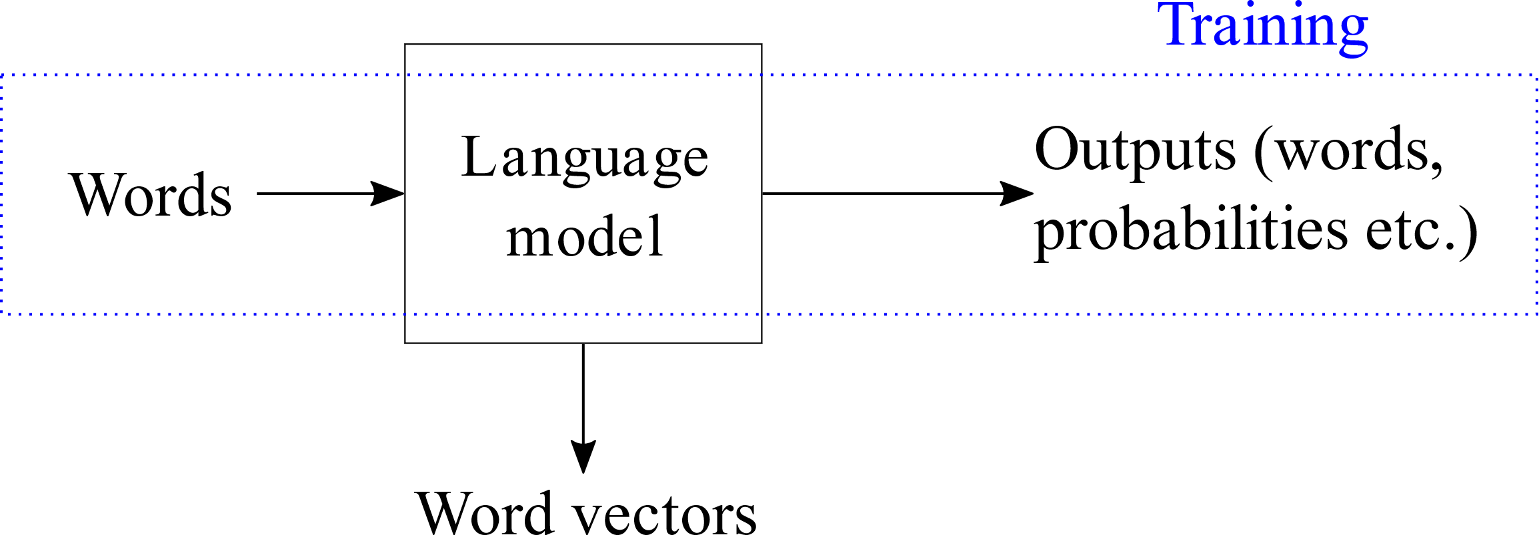
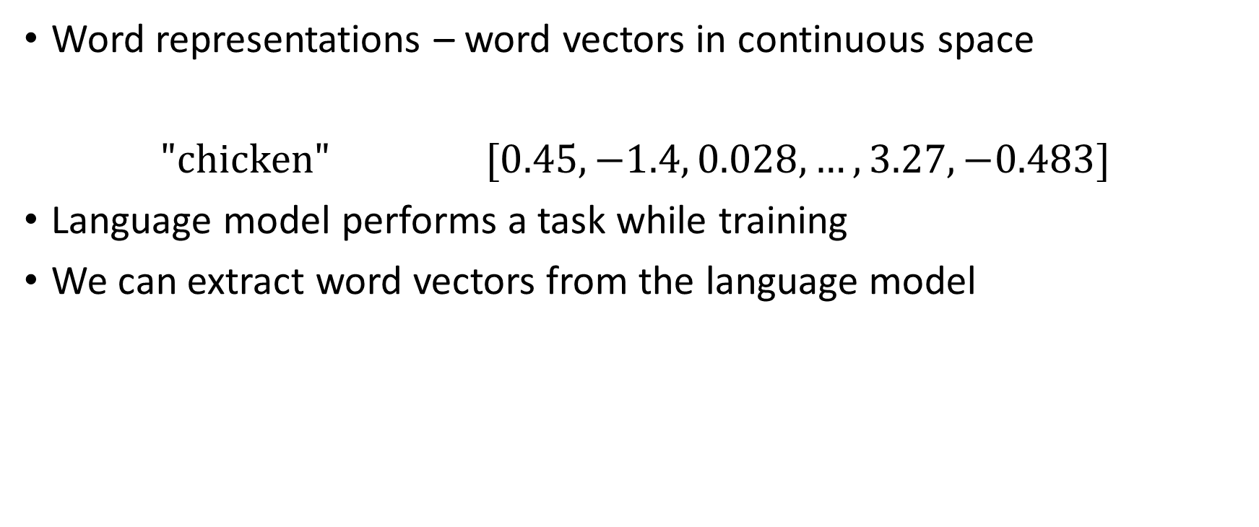
Vector Representation of Words
Word representations – word vectors in continuous space
$\text{"}\text{chicken}\text{"}$ $[0.45, −1.4, 0.028, …, 3.27, −0.483]$
Language model performs a task while training
We can extract word vectors from the language model

Slide 4
Language Models
4 language models:
Feedforward neural network language model (NNLM)
Recurrent neural network language model (RNNLM)
Continuous Bag-of-Words model (CBOW)
Continuous Skip-gram model
Context words and target words

Slide 5
Feedforward and Recurrent NNLMs
Feedforward NNLM: Given N context words, it predicts the target word.
  Context words appear before the target word
RNNLM: It predicts the target word without any fixed length of the context
  Entire word/sentence history can be considered “context”

Slide 6
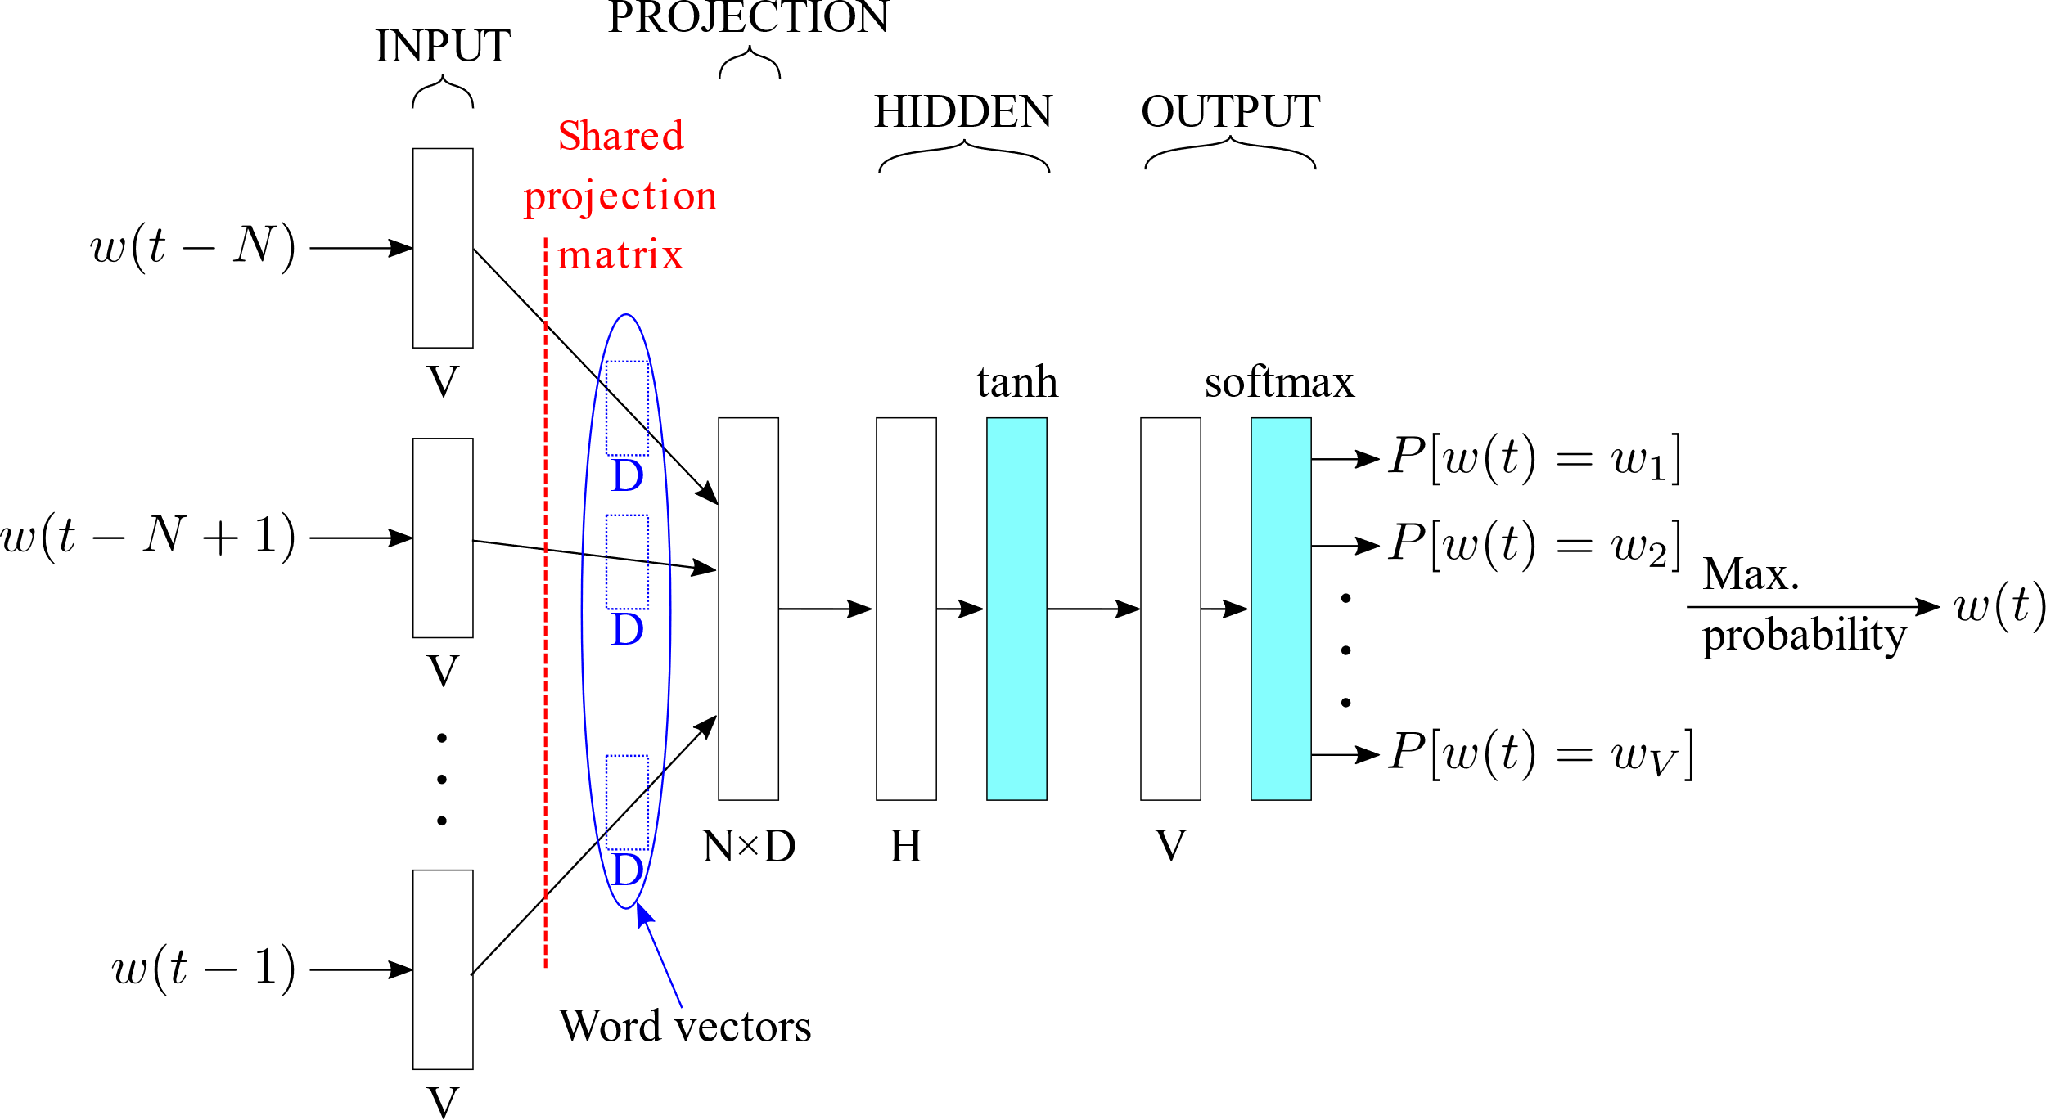
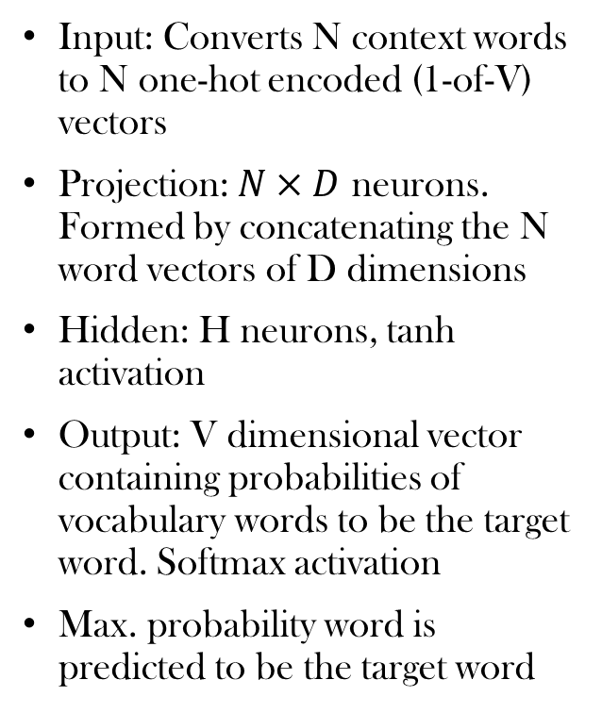
Feedforward NNLM
Input: Converts N context words to N one-hot encoded (1-of-V) vectors
Projection: $N×D$ neurons. Formed by concatenating the N word vectors of D dimensions
Hidden: H neurons, tanh activation
Output: V dimensional vector containing probabilities of vocabulary words to be the target word. Softmax activation
Max. probability word is predicted to be the target word

Slide 7
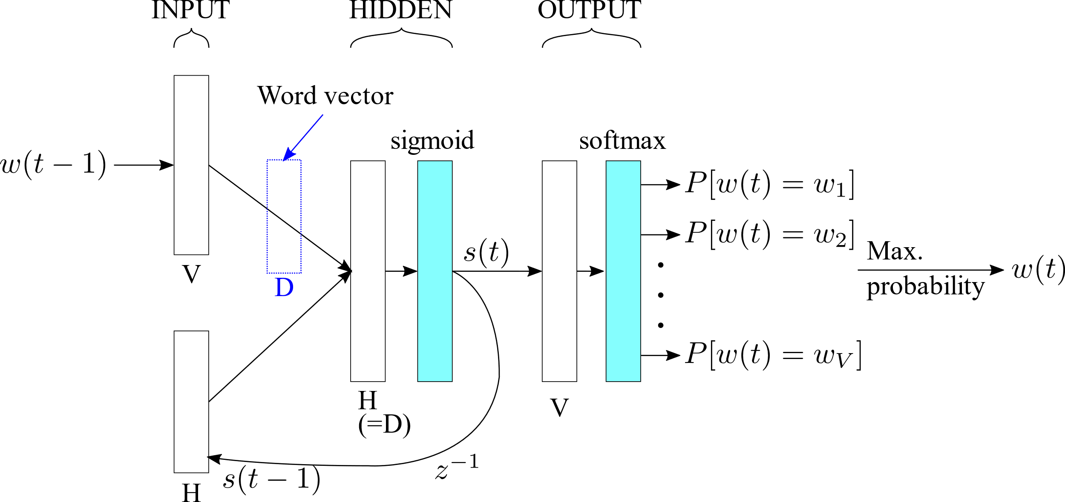
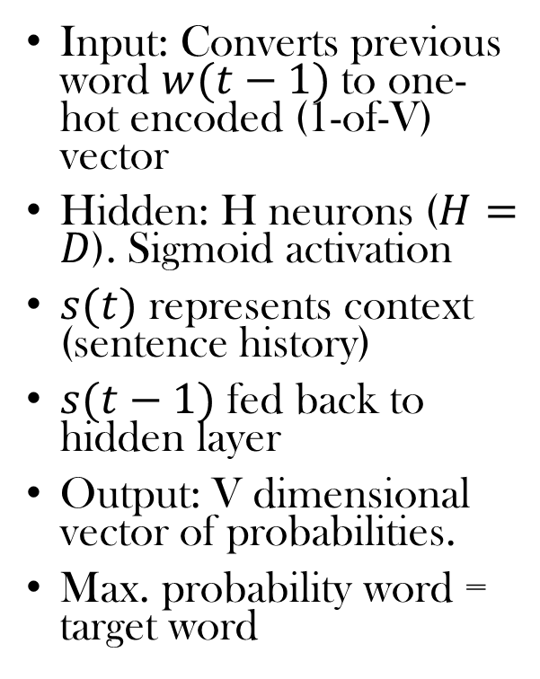
RNNLM
Input: Converts previous word $w(t−1)$ to one-hot encoded (1-of-V) vector
Hidden: H neurons ($H=D$). Sigmoid activation
$s(t)$ represents context (sentence history)
$s(t−1)$ fed back to hidden layer
Output: V dimensional vector of probabilities.
Max. probability word = target word

Slide 8
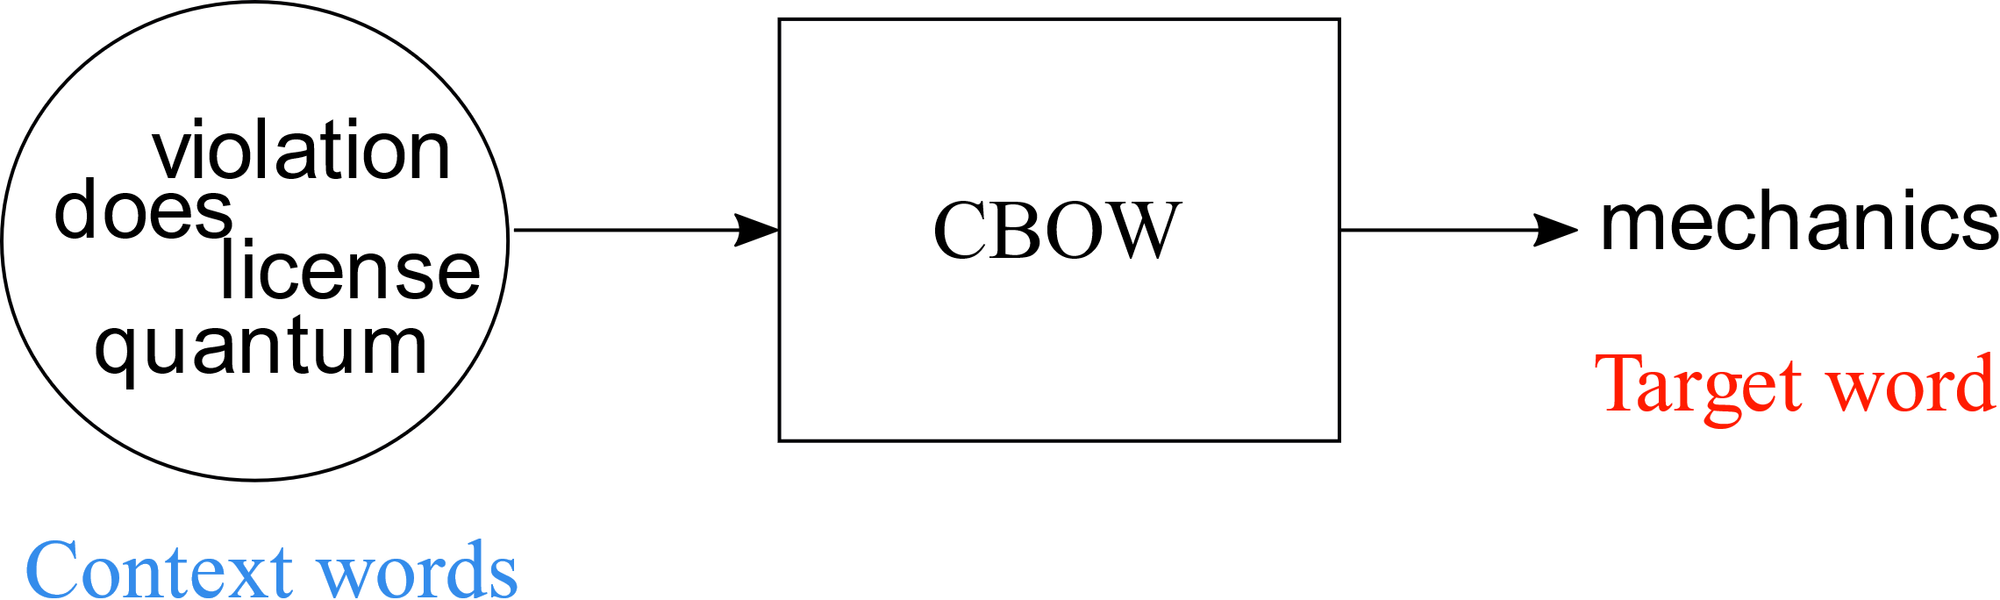
The Continous Bag-of-Words (CBOW) Model
Given context words, CBOW tries to predict target word.
N words before target word, N words after target word
…Nowhere does quantum mechanics license violation of energy conservation…
Target word
Context words

Slide 9
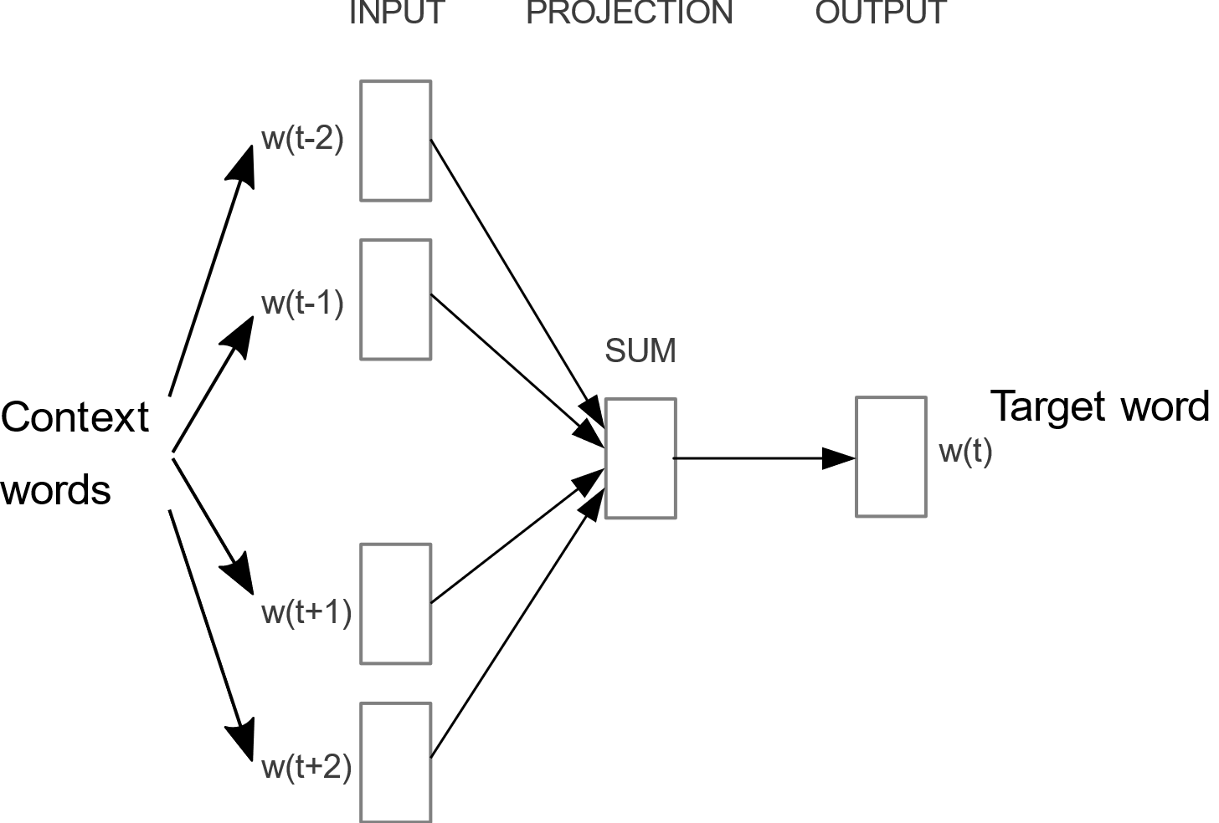
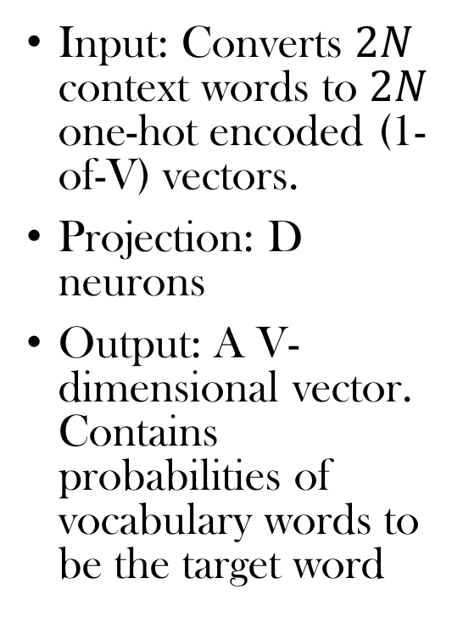
The Continuous Bag-of-Words (CBOW) Model
Input: Converts $2N$ context words to $2N$ one-hot encoded (1-of-V) vectors.
Projection: D neurons
Output: A V-dimensional vector. Contains probabilities of vocabulary words to be the target word

Slide 10
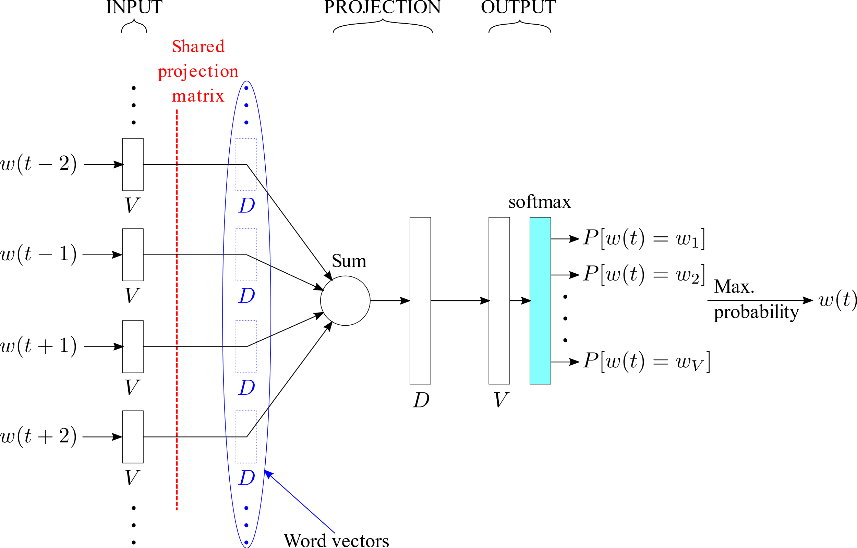
The Continuous Bag-of-Words (CBOW) Model
Shared projection matrix (weight matrix) is used to get word vectors (D dimensions)
Word vectors are averaged to get the projection layer (D dimensions)
Softmax for getting probabilities
The word with the maximum probability is predicted as target word

Slide 11
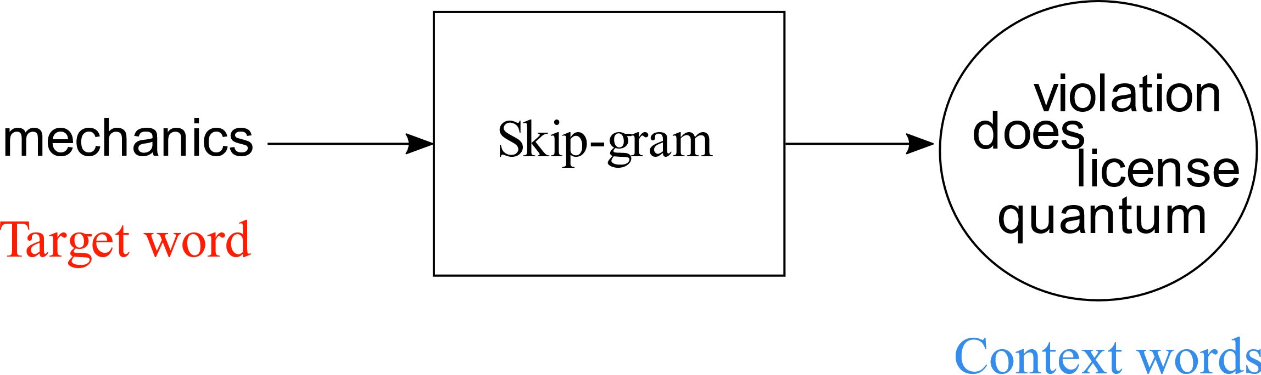
The Skip-gram Model
Reverse of the CBOW model
Given target word, Skip-gram tries to predict context words before and after it
…Nowhere does quantum mechanics license violation of energy conservation…
Target word
Context words

Slide 12
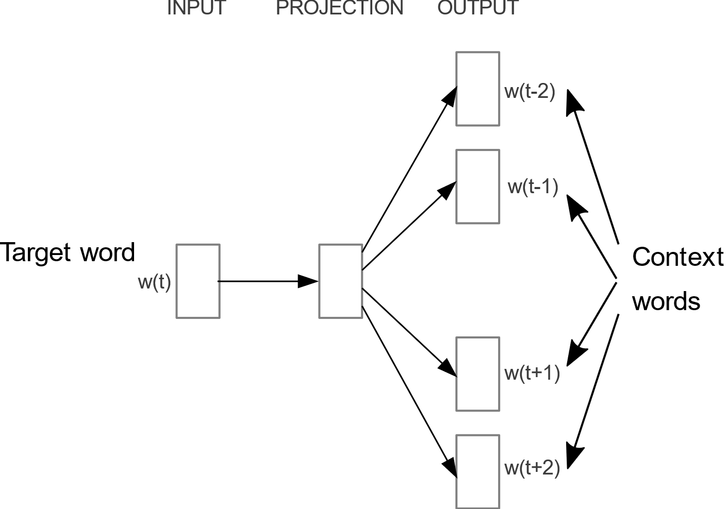
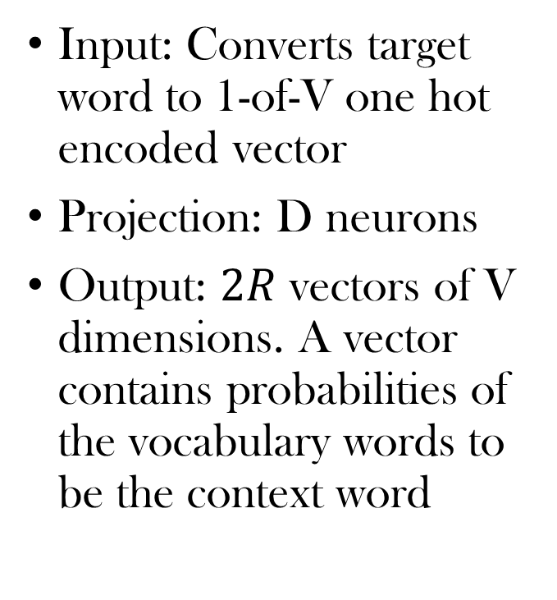
The Skip-gram Model
Input: Converts target word to 1-of-V one hot encoded vector
Projection: D neurons
Output: $2R$ vectors of V dimensions. A vector contains probabilities of the vocabulary words to be the context word

Slide 13
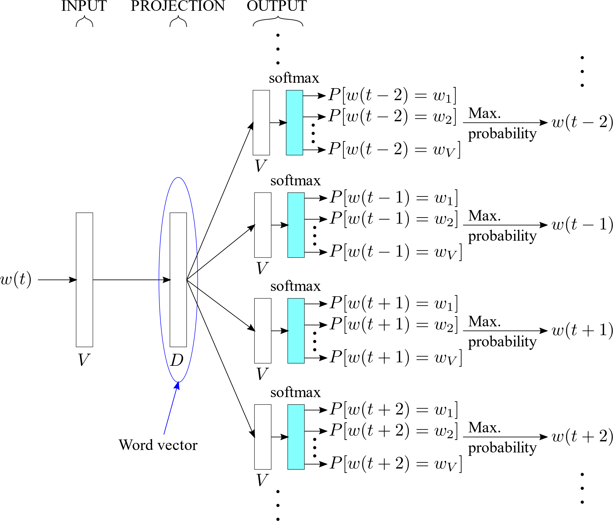
The Skip-gram Model
Max. probability word is the predicted context word
Projection layer (D dimensions) is the word vector of the target word
Softmax is used to get probabilities

Slide 14
Experiments and Results
Main task: Finding words with syntactic and semantic similarities
Evaluating performance of CBOW for different word vector dimensionalities and training dataset size
Comparison of models
Evaluating parallel CPU training of models
Microsoft Sentence Completion Challenge

Slide 15
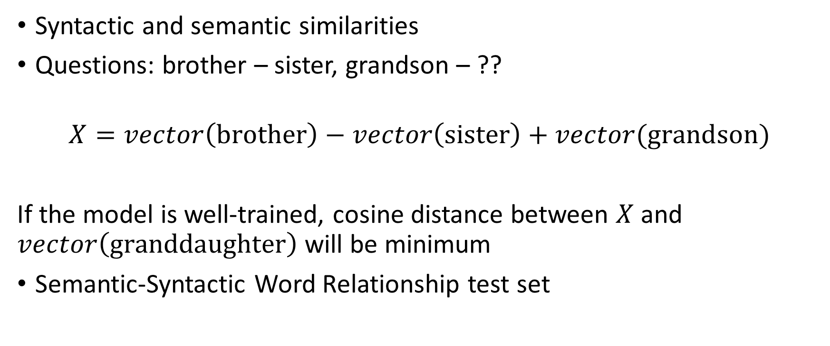
Results: Main Task
Syntactic and semantic similarities
Questions: brother – sister, grandson – ??
$$X=vector\left(\text{brother}\right)−vector\left(\text{sister}\right)+vector(\text{grandson})$$
If the model is well-trained, cosine distance between $X$ and $vector\left(\text{granddaughter}\right)$ will be minimum
Semantic-Syntactic Word Relationship test set

Slide 16
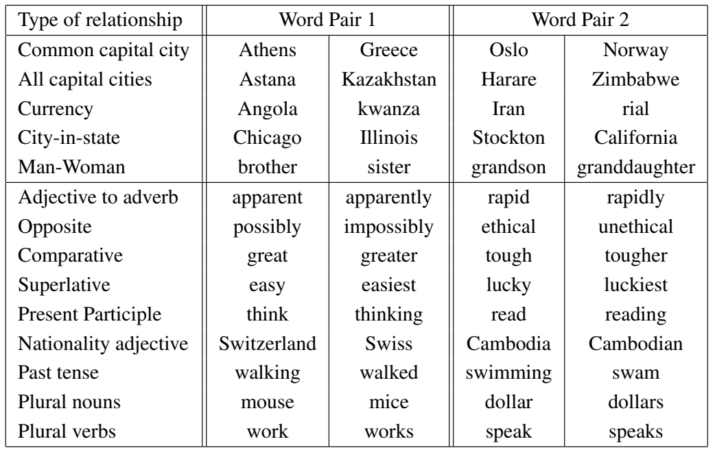
Results: Main Task
5 types of semantic questions, 9 types of syntactic questions
8869 semantic questions, 10675 syntactic questions
Single-token words
Synonyms are considered mistakes

Slide 17
Results: Maximizing Accuracy of CBOW
Training data:
  Google News corpus
  6 billion tokens
  Vocabulary: 1 million most frequently used words
Subsets of the training data with varying sizes are used for training
Dimensionality of the word vectors is also varied
Test data: Semantic-Syntactic Word Relationship test set
Stochastic gradient descent (with linearly decreasing learning rate)
3 epochs
Accuracy of CBOW model is evaluated

Slide 18
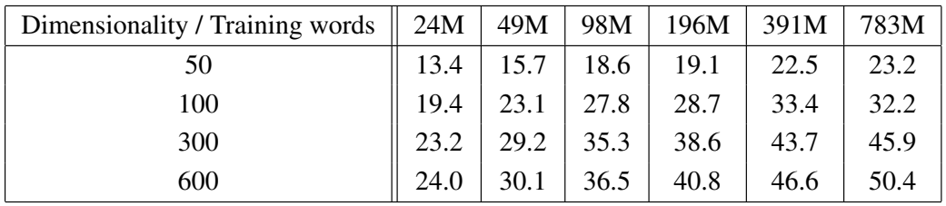
Results: Maximizing Accuracy of CBOW
Accuracy of the CBOW model
Only increasing number of dimensions or amount of training provides diminishing returns
Need to increase both simultaneously

Slide 19
Results: Comparison of Models
Training data:
  Multiple LDC corpora
  320 million words
  Vocabulary: 82 thousand words
Test data:
  Semantic-Syntactic Word Relationship test set
  Microsoft Research syntactic test set
    Formed using Penn Treebank
    8000 words
Feedforward NNLM, RNNLM, CBOW, Skipgram models are compared

Slide 20
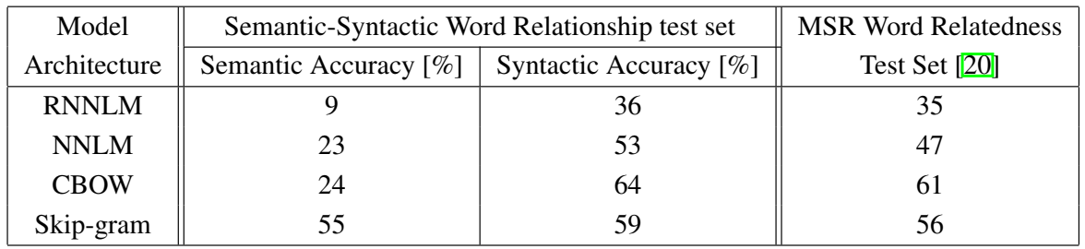
Results: Comparison of Models
Comparison of performance of different architectures
640 features of word vectors
Overall, CBOW and Skipgram perform better.
Semantic relation: Skipgram; Syntactic relation: CBOW

Slide 21
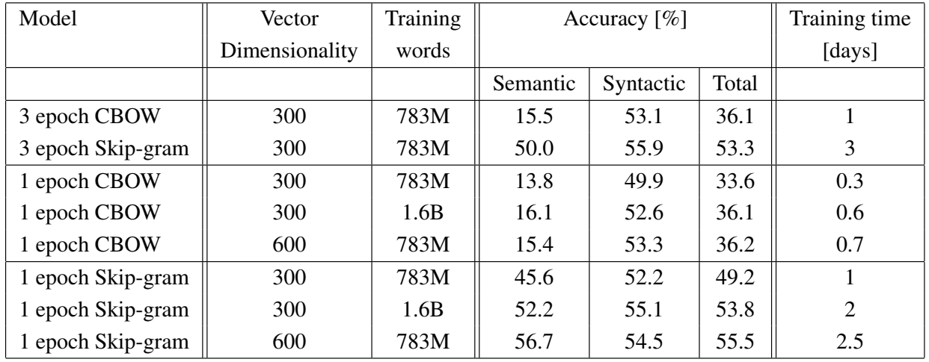
Results: Comparison of Models – Training Speed
Single epoch, double training data give results comparable to 3-epoch

Slide 22
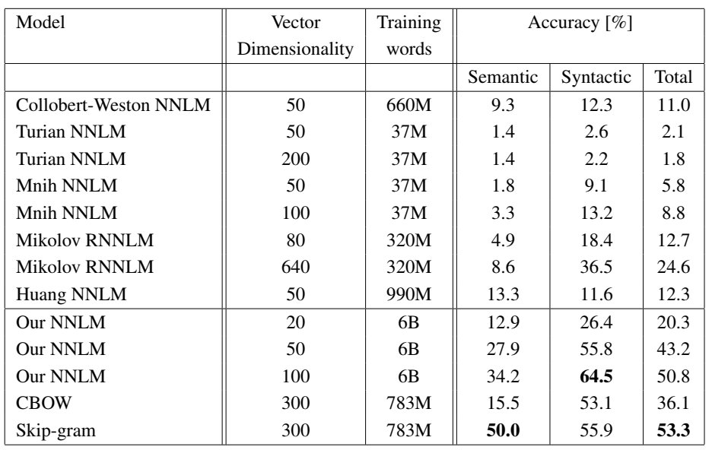
Results: Comparison of Models
Comparison with other publicly available models for word vectors
Training:
  CBOW, Skipgram: Subset of Google News corpus
  NNLM: Full Google News corpus
  SGD (decreasing learning rate), 3 epochs
CBOW and Skipgram perform better
Total accuracy is highest for Skipgram

Slide 23
Results: Parallel Training
Parallel CPU training using a distributed framework DistBelief
Training data: Google News corpus
Test data: Semantic-Syntactic Word Relationship test set
Adagrad, single epoch

Slide 24
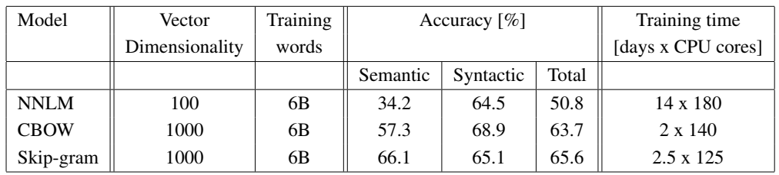
Results: Parallel Training
Comparison of models trained using a distributed framework
NNLM takes significantly more time, even when the vector dimensionality is lower

Slide 25
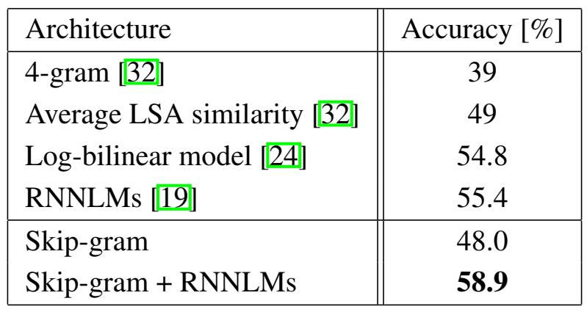
Results: Microsoft Sentence Completion Challenge
One word of a sentence is missing, 5 options for the missing word are given. The model has to choose the best one.
1040 sentences
Skipgram alone does not perform better, but combined with RNNLMs, it can give better results than the (then) state-of-the-art
Comparison of models on the Microsoft Sentence Completion Challenge

Slide 26
Conclusions
CBOW and Skip-gram perform very well
High quality word vectors from simple models
They require less computational resources
They can be trained on huge datasets if necessary
Skip-gram combined with other models produced better results than the (then) state-of-the-art
The models can be used for other NLP tasks

